Slide 1

group 8 linear circuits

Slide 2

UNIVERSITY OF GHANA

Slide 3

COURSE PROJECT
Members
Saani Mustapha Deshini - 10978425

Slide 4
INTRODUCTION
This project delves into the realm of Amplitude Modulation radio, a foundational communication technology that has withstood the test of time
In a collaborative effort to bridge the gap between theoretical knowledge and practical implementation, this report presents an in-depth exploration of the simulation of an AM radio communication system using the versatile Proteus software
The project serves as an exemplar of bridging the gap between theory and application, reaffirming the vitality of analog communication techniques even in an increasingly digital world

Slide 5
PROBLEM DEFINITION
Signal Generation: The device should generate a high-frequency carrier signal that serves as the carrier wave for modulating the audio signal
Modulation: The AM radio system should be capable of modulating the carrier signal with the audio signal to produce the amplitude-modulated waveform
Transmission: The modulated signal should be transmitted effectively using an appropriate antenna and transmission system
Reception: The device should be equipped with a sensitive and selective receiver that can capture the transmitted AM signal, filter out unwanted noise and interference, and extract the modulated audio signal from the received waveform

Slide 6
PROBLEM DEFINITION
Demodulation: The demodulation process is crucial in extracting the original audio signal from the received AM waveform
Audio Amplification and Playback: After demodulation, the extracted audio signal should be appropriately amplified to a suitable level for playback through speakers or headphones
Noise Reduction: To improve signal quality, the device should incorporate noise reduction techniques that minimize background noise, static, and interference, enhancing the clarity of the received audio

Slide 7
DESIGN OBJECTIVES
Modulation Scheme Selection: Choose an appropriate modulation scheme for the AM radio system, considering factors such as modulation index, bandwidth utilization, and signal fidelity to ensure optimal transmission and reception
Transmitter Architecture: Design a robust transmitter architecture that generates a stable carrier signal and effectively combines it with the modulating audio signal while meeting regulatory standards for output power
Signal Amplification and Filtering: Design signal amplifiers and filters for both the transmitter and receiver sections to ensure proper signal strength, bandwidth control, and noise reduction, contributing to overall signal quality

Slide 8
DESIGN OBJECTIVES
Demodulation Strategy: Devise a demodulation technique that accurately separates the modulating audio signal from the received AM waveform, considering methods such as envelope detection or synchronous detection
Noise Reduction Techniques: Incorporate noise reduction algorithms or hardware components to improve signal-to-noise ratio, minimizing the impact of background noise and interference on audio quality
Realism and Simulation Verification: Verify the design's feasibility and effectiveness by comparing simulated results from Proteus with expected theoretical outcomes and, if possible, with real-world measurements

Slide 9

DESIGN METHODOLOGY

Slide 10
Requirement analysis and specifications
RF Reception: The system must effectively receive AM radio signals within the specified frequency range
Frequency Tuning: Users should be able to tune the receiver to different AM radio stations using a user-friendly tuning mechanism
Demodulation: The system must accurately demodulate the AM signal to extract the original audio content
Audio Playback: The demodulated audio signal should be amplified and played back through speakers or headphones
Selectivity: The system should have effective selectivity to separate desired signals from interference and adjacent stations
Noise Reduction: The receiver should incorporate noise reduction techniques to improve audio quality

Slide 11
Requirement analysis and specifications
Sensitivity: The system should have sufficient sensitivity to capture weak AM signals
Audio Quality: Demodulated audio should be clear and free from distortion and noise
Selectivity: Selectivity should be high to reject interference from adjacent stations
Frequency Accuracy: Tuning accuracy should be within acceptable limits to ensure proper station selection
Signal-to-Noise Ratio: The system should provide a high signal-to-noise ratio for optimal audio quality
Antenna: An appropriate AM radio antenna should be designed for efficient reception
Tuner Circuit: A frequency tuning circuit using variable capacitors or varactor diodes should be integrated
Amplifiers: Audio amplification stages should be included for adequate audio playback

Slide 12

Requirement analysis and specifications
Filters: IF filters and noise reduction filters should be implemented for signal conditioning
MC1496 balanced modulator-demodulator IC
Passive components: resistors, capacitors
LM358 audio amplifier
10K potentiometer

Slide 13

The transmitter
The transmitter is a critical component within the AM radio communication system setup, responsible for generating, modulating, and transmitting the carrier signal combined with the audio information
It plays a pivotal role in encoding the audio content onto the carrier wave, enabling its propagation over the airwaves for reception by distant receivers

Slide 14
Transmitter subsystems
Carrier Signal Generator: The RF oscillator of the transmitter generates a stable carrier signal, which serves as the foundation for the AM modulation process
Modulation Circuitry: The modulation circuitry within the transmitter is responsible for combining the carrier signal and the audio input signal
Amplification circuitry: Following modulation, the transmitter features an amplification circuitry made up of resistors and capacitors that boosts the power of the modulated signal
Antenna Connection: The amplified and modulated signal is then connected to an antenna, which serves as the conduit for the electromagnetic wave to be radiated into the surrounding space

Slide 15
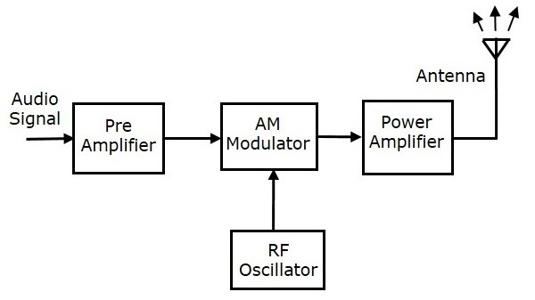
Block diagram/system operation flow diagram of the transmitter

Slide 16
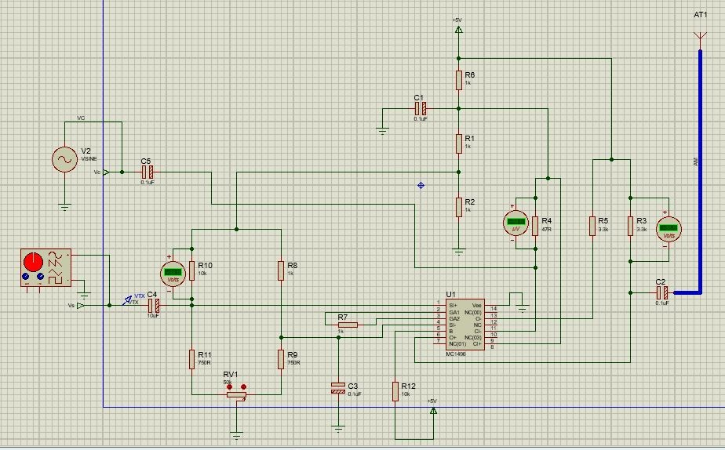
Proteus model of the transmitter

Slide 17
How the subsystems of the transmitter function together
In the AM transmitter above, the information signal is applied at the VS port
The carrier signal is applied at the VC port which is connected to pin 8 and
The resistors connected to the input and output ports are for biasing the internal differential amplifier circuitry inside the modulator IC
The audio signal from the output of the microphone is sent to the pre-amplifier, which boosts the level of the modulating signal
The RF oscillator generates the carrier signal, which was fed to VC
Both the modulating and the carrier signal is sent to AM modulator, to be modulated
Power amplifier is used to increase the power levels of the AM wave

Slide 18
The receiver
The receiver is a vital component within the AM radio communication system setup, responsible for capturing, demodulating, and processing the transmitted AM signal to extract the original audio information
It plays a crucial role in converting the received electromagnetic signal back into a usable audio format

Slide 19
Receiver subsystems
Antenna Reception: The receiver begins by capturing the modulated AM signal transmitted by the transmitter
RF Tuner section: The RF tuner section in an AM radio receiver is responsible for selecting and tuning to a specific radio station's carrier frequency from the available radio frequency spectrum
RF-IF Converter: The RF-IF converter is a crucial component found in radio receivers, including AM radio receivers
IF Filter: The Intermediate Frequency filter is a critical component in the radio frequency signal processing chain of a receiver, such as an AM radio receiver
AM Demodulator: The AM demodulator, also known as the detector, is a crucial component in an AM radio receiver

Slide 20

Receiver subsystems
Low Pass Filter circuit: The filter circuit in a receiver serves the essential purpose of selecting or rejecting specific frequency components from the received signal
Amplifier: It increases the levels of the extracted audio signal and feeds it into the speaker

Slide 21
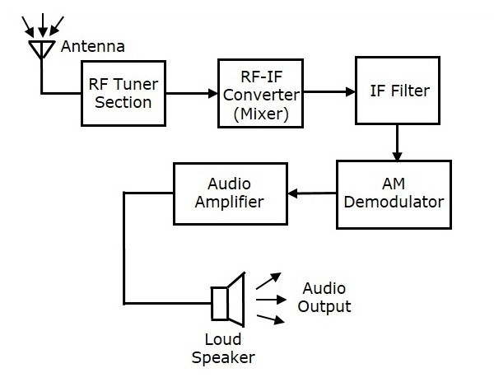
Block diagram of the receiver

Slide 22
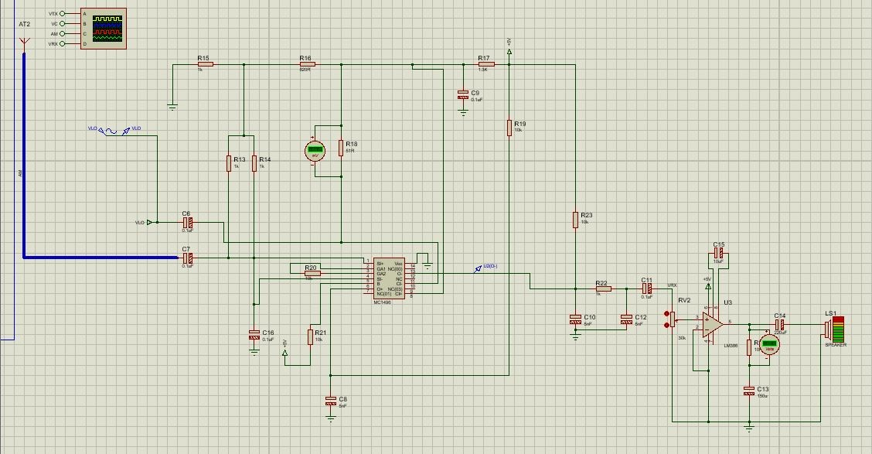
Proteus model of the receiver

Slide 23

Filter design specification and analysis
Filter Functionality and Purpose: The filter within the receiver serves the critical function of enhancing selectivity by isolating the desired intermediate frequency range while attenuating unwanted frequencies
Type: The filter should be a low-pass filter, allowing frequencies below the intermediate frequency to pass while attenuating higher frequencies

Slide 24

Filter design specification and analysis
Cut-off Frequency: The cut-off frequency of the filter should be set just above the intermediate frequency to ensure minimal signal distortion in the passband

Slide 25
How the subsystems of the receiver function together
At the receiver, the local oscillator signal is applied to the port VLO
The carrier signal frequency should be same as the transmit RF carrier frequency used at the RF transmitter
The received AM signal via the RF antenna is applied to the pin 1 via the 0.1µF coupling capacitor
The AM demodulator mixes the input AM signal with the local oscillator carrier signal
The message signal plus some noise passes from the demodulator output to a low pass filter
After the filter, the signal is then coupled using the coupling capacitor C13 into the audio amplifier circuit
From the amplifier circuit, the signal is fed into the speaker

Slide 26

IMPLEMENTATION AND TEST RESULTS

Slide 27

Procedure for the integration of hardware units
Audio Source: Start with an audio source (e.g., microphone, audio player) providing the signal.
Modulation Circuit: Connect the audio source to a modulation circuit using amplitude modulation (AM).
Carrier Oscillator: Link the modulation circuit output to a carrier oscillator for generating the carrier signal.
Mixer Circuit: Connect the carrier signal to a mixer circuit that can incorporate frequency multiplication.
Power Amplification: Connect the mixer circuit output to a power amplifier, maintaining linearity for distortion prevention.
Antenna and RF Front-End: Connect the power amplifier output to the antenna and RF front-end circuitry, ensuring impedance matching and grounding.

Slide 28
Antenna and RF Front-End: Describe connecting the antenna to the RF front-end with tuning and amplification stages.
RF-IF Conversion: Explain the RF-IF converter's role in down-converting the RF signal to intermediate frequency (IF).
Filtering and IF Amplification: Mention using an IF filter to select the desired IF range and an IF amplifier for sensitivity enhancement.
AM Demodulation: Describe the demodulator circuit extracting the original audio signal.
Audio Signal Filtering: Explain noise filtering after demodulation using components like R22 and C10.
Audio Amplification: Highlight the audio amplifier circuit that strengthens the extracted audio signal.
Audio Playback: Mention routing the amplified audio signal to the audio playback component (speaker) for audible output.

Slide 29

TESTING OF NUMERICAL MODEL AND RESULTS OBTAINED

Slide 30
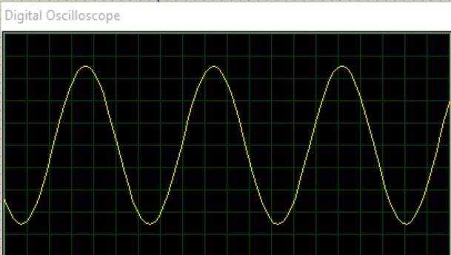
AM Transmitter Testing
During simulation, we captured screenshots at key stages

Slide 31
Interpretation
Constant Amplitude: The consistency in the amplitude of the sine wave correspond to the limited variation of the original audio signal's loudness or intensity, for the purpose of this project
Sine Wave Shape: The sine wave shape of the modulating signal is indicative of a pure audio tone

Slide 32
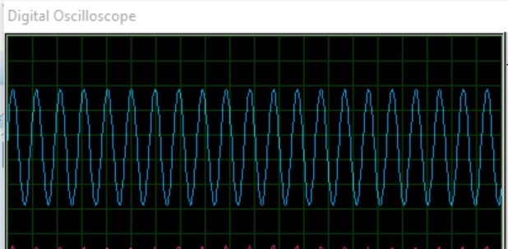
2. Carrier Signal
This screenshot reveals the constant carrier signal

Slide 33
Interpretation
Frequency of Carrier Signal: The frequency of the sine wave corresponds to the carrier frequency, which is typically much higher than the audio frequencies being transmitted, as can be seen by comparing the two graphs above
Steady Amplitude: The steady and consistent amplitude of the sine wave indicates that the carrier signal's amplitude is not varying
Sine Wave Shape: The smooth oscillation of the sine wave indicates that the carrier signal maintains its sinusoidal shape throughout time

Slide 34
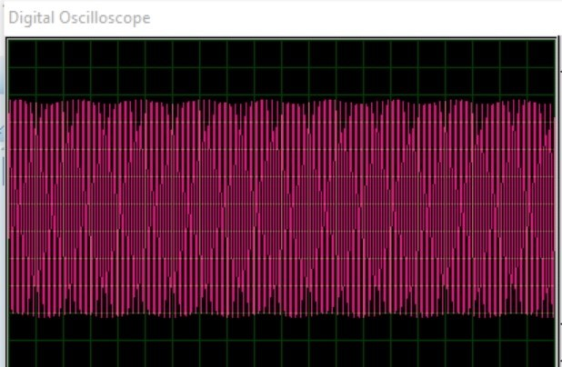
3. Modulated AM Signal

Slide 35
Interpretation
Amplitude Variations: The pronounced amplitude variations in the waveform correspond to the variations in the original audio signal's loudness or intensity
Compression of Amplitude: The "compression" that is observed signifies the amplitude modulation of the carrier signal
Similar Crests and Troughs: The similarity in crests and troughs within the sub-compressed segments indicates that the audio signal's characteristics are consistent over short intervals
Sub-Compressed Segments: The sub-compressed sections represent specific periods where the audio signal's amplitude varies more dramatically

Slide 36
AM Receiver Testing

Slide 37
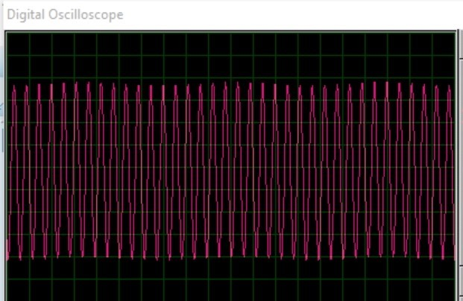
Received AM Signal
We executed the simulation and captured screenshots at key stages

Slide 38
Interpretation
Amplitude Variations: The subtle amplitude variations you're observing are a result of the demodulation process
Slight Wave Distortion: The additional wavy variations in the sine wave are introduced during the demodulation process
Demodulated Audio Content: The graph represents the demodulated audio signal that has been successfully extracted from the received AM signal

Slide 39
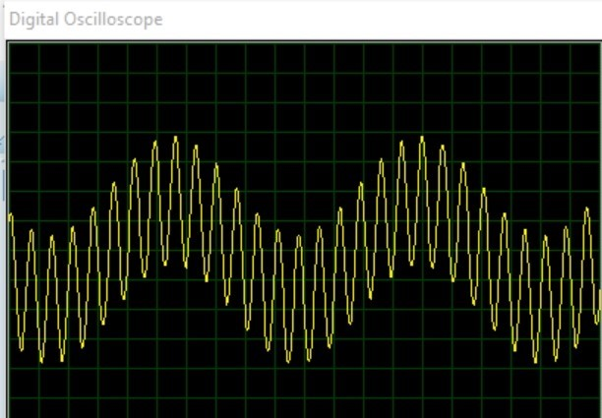
Modulated Message Signal
We executed the simulation and captured screenshots at key stages

Slide 40
Interpretation
Amplitude Variations: The increased and more noticeable amplitude variations are a direct result of the amplitude modulation process
Wavier Waveform: The larger and more pronounced wavy variations in the sine wave are indicative of the characteristics of the original audio signal that was used to modulate the carrier
Recovered Audio Content: The graph illustrates the demodulated audio signal, which has been successfully recovered from the received AM signal

Slide 41
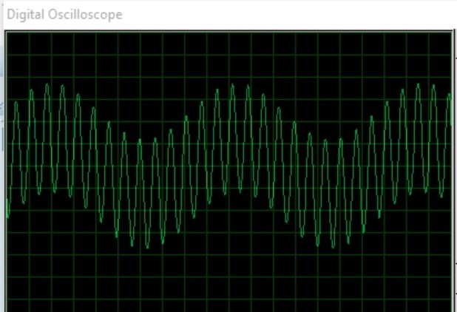
Amplified Audio Signal
We executed the simulation and captured screenshots at key stages

Slide 42
Interpretation
Amplitude Variations: The amplitude variations in the amplified audio signal match those of the demodulated signal, but the difference is that, the amplified audio signal has a higher amplitude compared to the demodulated signal in its pure form
Matching Frequency: The frequency of the amplified audio signal matches that of the demodulated signal, which is the frequency of the original audio content

Slide 43

Overall System Evaluation

Slide 44
Functionality and Integration
The AM transmitter and receiver sections collaborate effectively
The transmitter modulates the carrier signal with audio, while the receiver successfully extracts and amplifies the audio signal

Slide 45

Validation of Objectives
Simulation results confirm alignment with intended objectives
Modulated AM signal and demodulated audio signal demonstrate successful modulation and demodulation

Slide 46
CONCLUSION
The design process encompassed a thorough understanding of each hardware unit's functionality, their interconnections, and their roles within the overall system architecture
The simulation phase within the Proteus environment provided a valuable opportunity to validate the design's functionality, analyze performance characteristics, and identify potential areas for optimization
Through the collaboration of design, simulation, and testing, this project serves as a testament to the capability and ingenuity within the field of electronics and communication engineering

Slide 47

REFERENCES
Malvino, A., & Bates, D. J
Haykin, S., & Moher, M
Razavi, B
https://www.ee-diary.com/2022/09/am-radio-communication-system.html
https://www.tutorialspoint.com/analog_communication/analog_communication_receivers.htm

